Slide 1
zekeLabs
Cassandra - Internals
Learning made Simpler ! www.zekeLabs.com

Slide 2
Coordinator
Partitioner
Replication
Replication Strategy
Replication Factor
Write consistency Level
Write Flow
Hinted Handoff
Write Internels
Agenda

Slide 3
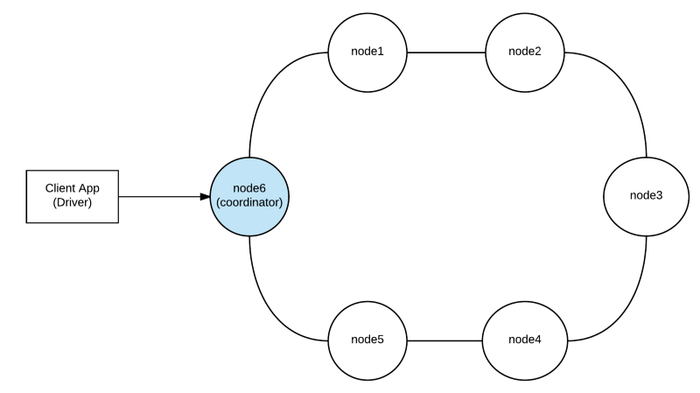
Coordinator

Slide 4
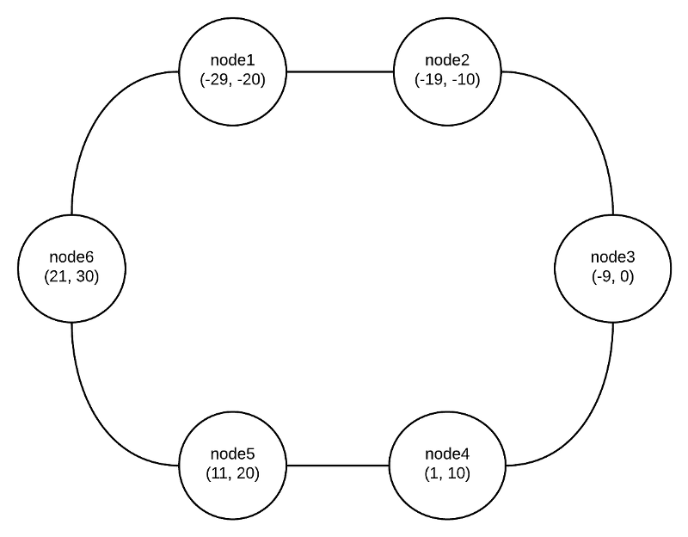
Partitioner

Slide 5
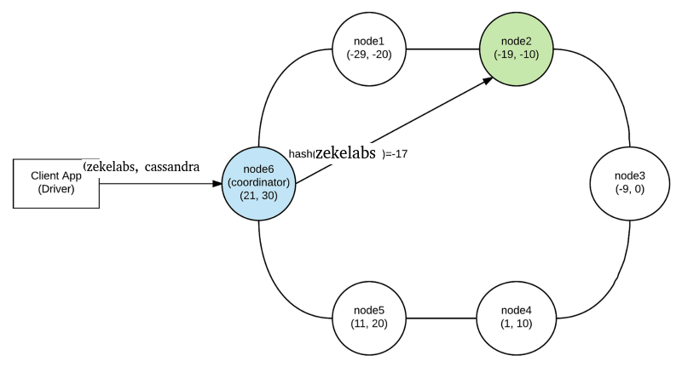
Partitioning ...

Slide 6
Replication
Cassandra offers automatic data replication and keeps your data redundant throughout different nodes in the cluster.
This means that you can even resist to node failure scenarios and your data would still be safe and available.

Slide 7
Replication Strategy
SimpleStrategy
NetworkTopologyStrategy

Slide 8
Replication Factor
The replication factor is the number of replicas that Cassandra will hold for this table in different nodes.
If you specify REPLICATION_FACTOR=3, then your data will be replicated to 3 different nodes throughout the cluster.

Slide 9
Write Consistency Level
client sends a request to a Cassandra node, this node is called a coordinator and acts as a proxy between the client and the replica nodes.
when you write to a table in Cassandra (inserting data, for example), you can specify the write consistency level.
The write consistency level is the number of replica nodes that have to acknowledge the coordinator that its local insert was successful (success here means that the data was appended to the commit log and written to the memtable).

Slide 10
Consistency ...
As soon as the coordinator gets WRITE_CONSISTENCY_LEVEL success acknowledgments from the replica nodes, it returns success back to the client and doesn’t wait for the remaining replicas to acknowledge success.
WRITE_CONSISTENCY_LEVEL=TWO to a table that is configured with REPLICATION_FACTOR=3, the coordinator will only return success to the application when two of the three replicas acknowledge success.
Types - ANY, ONE, TWO, THREE, QUORUM, LOCAL_QUORUM, EACH_QUORUM, ALL.

Slide 11
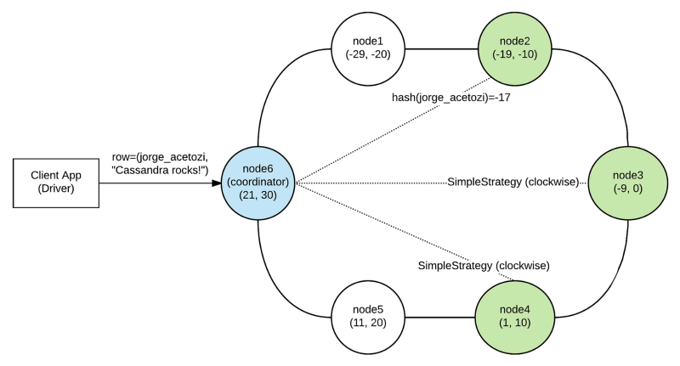
Write Flow on a 6-node cluster
WRITE_CONSISTENCY_LEVEL=TWO
TABLE_REPLICATION_FACTOR=3
REPLICATION_STRATEGY=SimpleStrategy

Slide 12
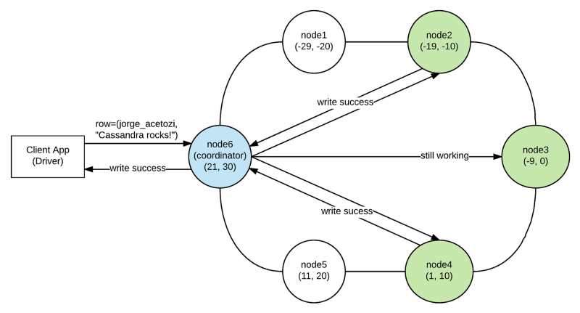
Write ...

Slide 13
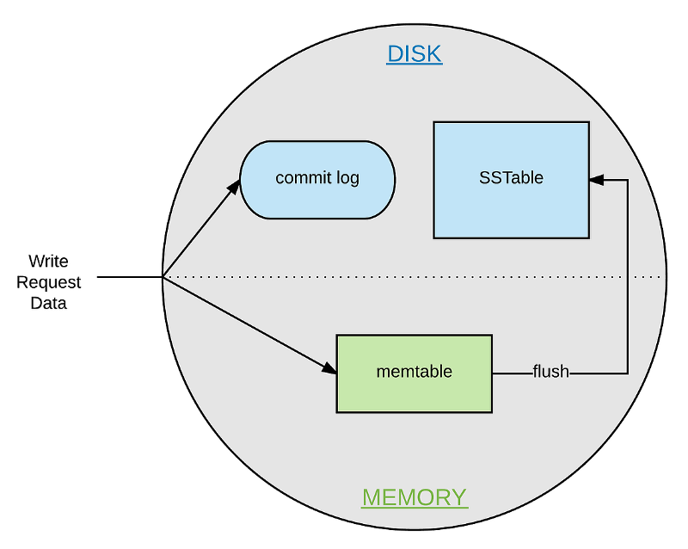
Write Internel
When write request reaches node
The write request is appended to the commit log in the disk. This ensures data durability
The write request is sent to the memtable (a structure stored in the memory). When the memtable is full, the data is flushed to a SSTable on disk using sequential I/O and the data in the commit log is purged.

Slide 14
Thank You !!!

Slide 15
THANK YOU
Let us know how can we help your organization to Upskill the employees to stay updated in the ever-evolving IT Industry.
Get in touch:
www.zekeLabs.com | +91-8095465880 | info@zekeLabs.com
Visit : www.zekeLabs.com for more details

